Slide 1
AM24 - Multi-Agent Systems
Planet Exploration

Slide 2
Agenda
Introduction
Design
Explorer Agent
Transporter Agent
Communication
Experiments

Slide 3
Introduction
The Assignment
The Agent Software Demonstration

Slide 4
Design
Overall design of the agent system
Environment
Base
Explorer
Transporter

Slide 5
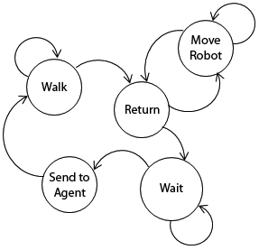
Explorer Agent
Behaviors
Queue

Slide 6
Explorer Agent Cont.
Perception method

Slide 7
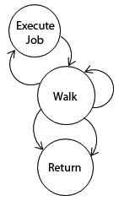
Transporter Agent
Moving
Job decision
Energy usage
Messaging

Slide 8
Experiments
1 base ”competitive” mode

Slide 11
Questions?

